Slide 1


Manhole Cover Defect Intelligent Recognition System
TONGJI
UNIVERSITY
Team Members
2154157 王梓鉴 2151030 李金昊
2151760 郭子瑜 2153604 郭晓杰

Slide 2

01
Project Introduction
02
Requirements and tasks
03
Project development plan
04
Current progress
05
Techniques and tools

Slide 3

01
Project
Introduction
· Project Background
· Project Description
PART ONE.

Slide 4
Project Background
Infrastructure growth has led to an increase in underground utility installations like communications and drainage systems. Manhole covers, integral to these networks, are at risk of damage due to their exposure to the elements and heavy urban use, which can lead to potential hazards. Current manual inspection methods for manhole covers are inefficient and resource-intensive. Adopting intelligent recognition technology to monitor manhole cover conditions is essential for enhancing management effectiveness and public safety.
Underground pipeline facilities are increasing
Complex outdoor environment caused serious damage to manhole cover
The efficiency of manual verification management is very low
Intelligent means should be introduced to improve the efficiency of management

Slide 5
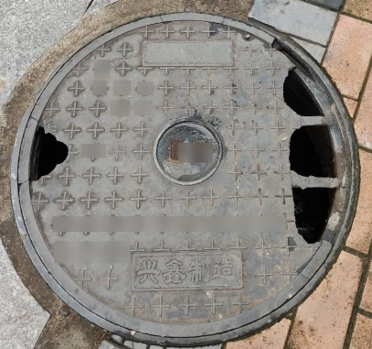
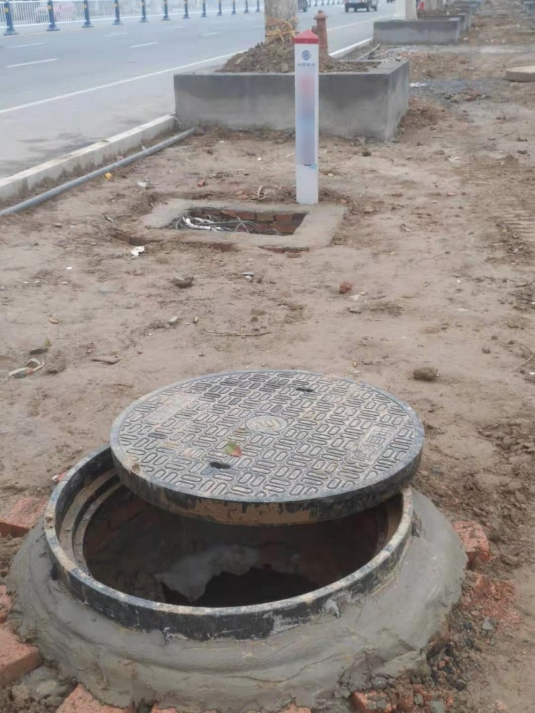
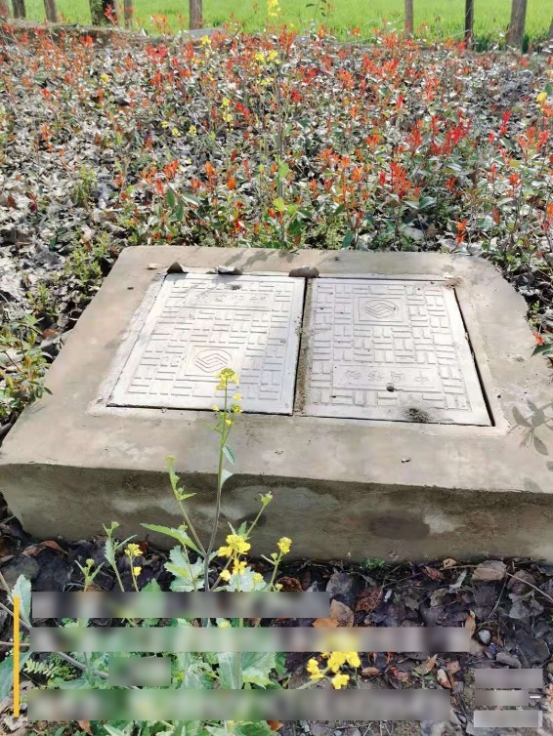
Project Description
Our project, stemming from a college competition on service outsourcing, utilizes AI to intelligently detect and classify hazards in manhole covers for efficient outdoor inspection, guided by the topic from China Mobile Research Institute.
High Volume: Average monthly maintenance work orders of 4,000 per province.
Widespread Distribution: Installed in urban and rural areas.
No Traceability: Lack of traceability after incidents occur.
Difficult to Control: Challenging to manage in a timely and unified manner.
There is an urgent need to introduce intelligent means
Image capture
Manhole cover defect identification
Result verification

Slide 6
02
Requirements
And Tasks
· RBS
· WBS
· Requirements and Tasks Analysis
PART TWO.

Slide 7
RBS
Manhole Cover Defect Intelligent Recognition System
Core business
Recognition system
Other requirements
Manhole Cover Defect Intelligent Recognition
Image recognition
Model comparison
User uploads image
Image recognition
System recognizes and returns the results
Video recognition
Optimization of recognition accuracy
Video recognition
User uploads video
System recognizes and returns the results

Slide 8
WBS
Manhole Cover Defect Intelligent Recognition System
Project management
Identify project requirements
Project development
System test
Deployment and maintenance
Manhole cover defect data requirements
System function test
System functional requirements
Data acquisition and preparation
Technical requirements and indicators
Model development
System performance test
Make project plan
User interface design
Project schedule management
Project risk management

Slide 9
Requirements and Tasks Analysis
Manhole Cover Defect Data Requirements
We need to use the training and testing datasets provided by the outsourcing service provider for training.
System functional Requirements
Introduce AI algorithms to achieve intelligent detection of manhole cover conditions for outdoor inspection and audit scenarios in transmission line routes. Identify whether there are hazards associated with manhole covers and categorize them into specific types, including 'intact', 'damaged', 'missing', 'uncovered', and 'ring issues'. Determine the specific category of manhole cover condition with hazards.
Task scenario | Business characteristics of the scenario
intact | The manhole cover and its surrounding ring are intact and undamaged, and they are securely positioned over the well.
damaged | The manhole cover shows cracks, gaps, or holes on its surface.
missing | The manhole cover is missing, leaving the well opening exposed.
uncovered | The manhole cover is tilted, raised, or shifted away from the well opening, resulting in incomplete coverage and the inability to tightly seal with well seat.
ring issues | The manhole ring is damaged while the manhole cover remains intact.

Slide 10

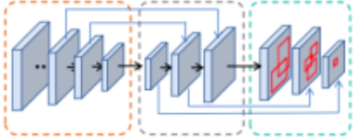

Requirements and Tasks Analysis
Technical requirements and indicators
Considering the practical business scenario, this project is based on object detection technology to recognize manhole cover hazards. Firstly, in the data preprocessing stage, methods such as data augmentation and data labeling can be employed to improve data quality. During the model training phase, we are not limited to the use of a single detection algorithm; instead, we can adopt the ensemble learning approach, training multiple models and merging their results to enhance model performance and generalization ability. Finally, suitable post-processing methods are chosen to output the recognition results of manhole cover hazards.
input
Detection network
output
preconditioning
Identification result
Postprocessing
backbone
neck
head
manual audit

Slide 11
03
Project
development plan
· Critical path diagram
· Gantt chart
PART THREE.

Slide 12
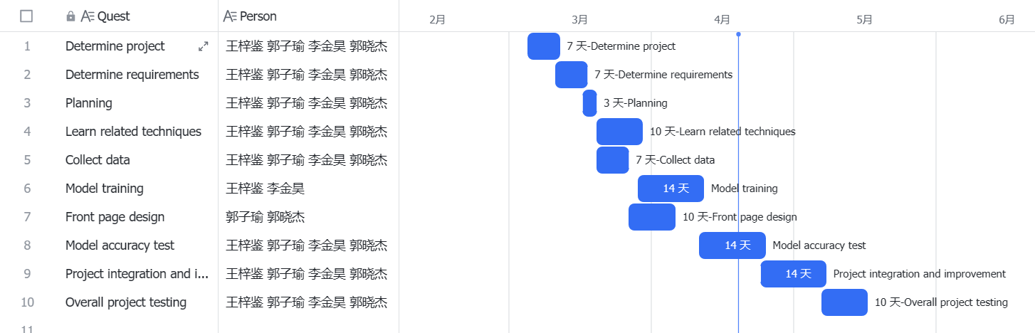
Gantt chart

Slide 13
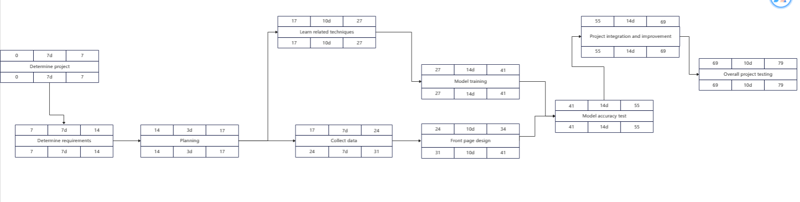
Critical path diagram

Slide 14
04
Current
progress
· Critical path diagram
· Burn chart
PART FOUR.

Slide 15
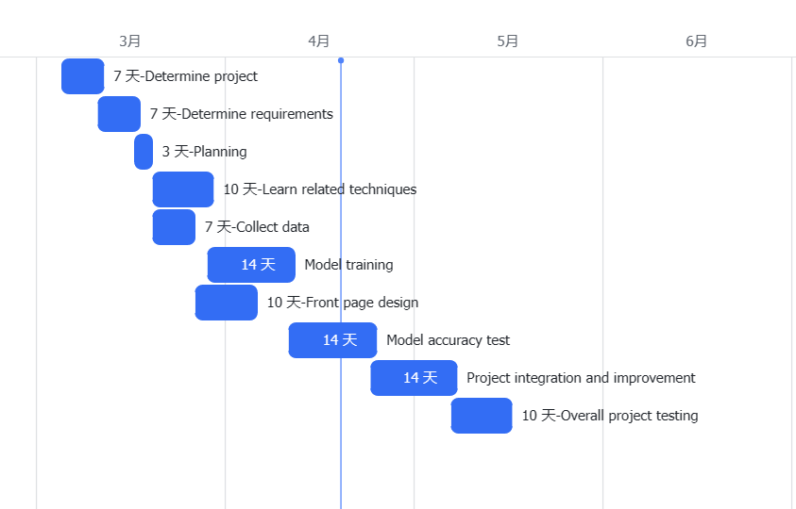
Gantt chart

Slide 16
Burn chart

Slide 17
05
Techniques
and tools
· Project management
· Periodic meeting
PART FIVE.

Slide 18

Project management
In the process of project development, the importance of project management is self-evident. It ensures that projects are completed on time, within budget, and meet high quality standards. Through efficient time and resource allocation, project management promotes teamwork, enhances communication, reduces risk, and ultimately improves the chances of success for software development projects.

Slide 19

Periodic meeting
· Discuss the problems encountered in the development process
Background
· Members demonstrate their work progress
· Develop a phased plan for the next development
· Evaluate current project completion

Slide 20

TONGJI
UNIVERSITY
感谢聆听
THANKS

